Slide 1
Day 5
Soc investigation process
- Presented by: Aditya jamkhande

Slide 2
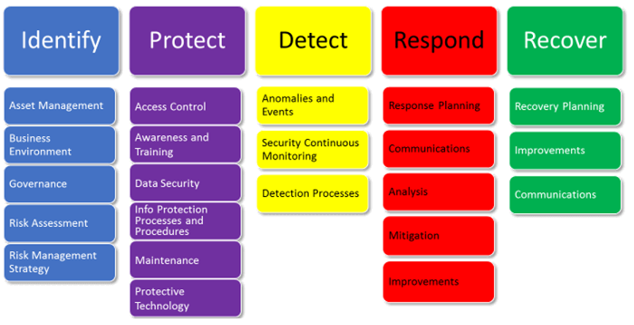
NIST Cyber Security framework

Slide 3
Core responsibilities
A SOC team has two core responsibilities:
Maintaining security monitoring tools – The team must maintain and update tools regularly. Without the correct and most up-to-date tools, they can’t properly secure systems and networks. Team members should maintain the tools used in every part of the security process.
Investigate suspicious activities – The SOC team should investigate suspicious and malicious activity within the networks and systems. Generally, your SIEM or analytics software will issue alerts which the team then analyzes and examines, triages, and discovers the extent of the threat.

Slide 4
Steps followed by analyst
Monitoring
Triage
Basic Investigation
Deep Dive Investigation
Remediation
Closure

Slide 5
Monitoring
Cybersecurity monitoring is the process of continuously observing what is happening in your organization’s ecosystem with the aim of detecting cyber threats and data breaches.
Done in the following way:
Monitor alerts, dashboards and reports
Identify Indicators of compromise or indicators of attack
Perform adhoc investigation

Slide 6
Alerts, dashboard and reports
Alerts
An alert is based on a scheduled saved or real time search that whenever certain conditions are overcome, generates one or more actions to be executed
Dashboards
A dashboard is a visual display of all of your data. While it can be used in all kinds of different ways, its primary intention is to provide information at-a-glance, such as KPIs
Reports
A cybersecurity report presents critical information about cybersecurity threats, risks within a digital ecosystem, gaps in security controls, and the performance of security programs at regular intervals

Slide 7
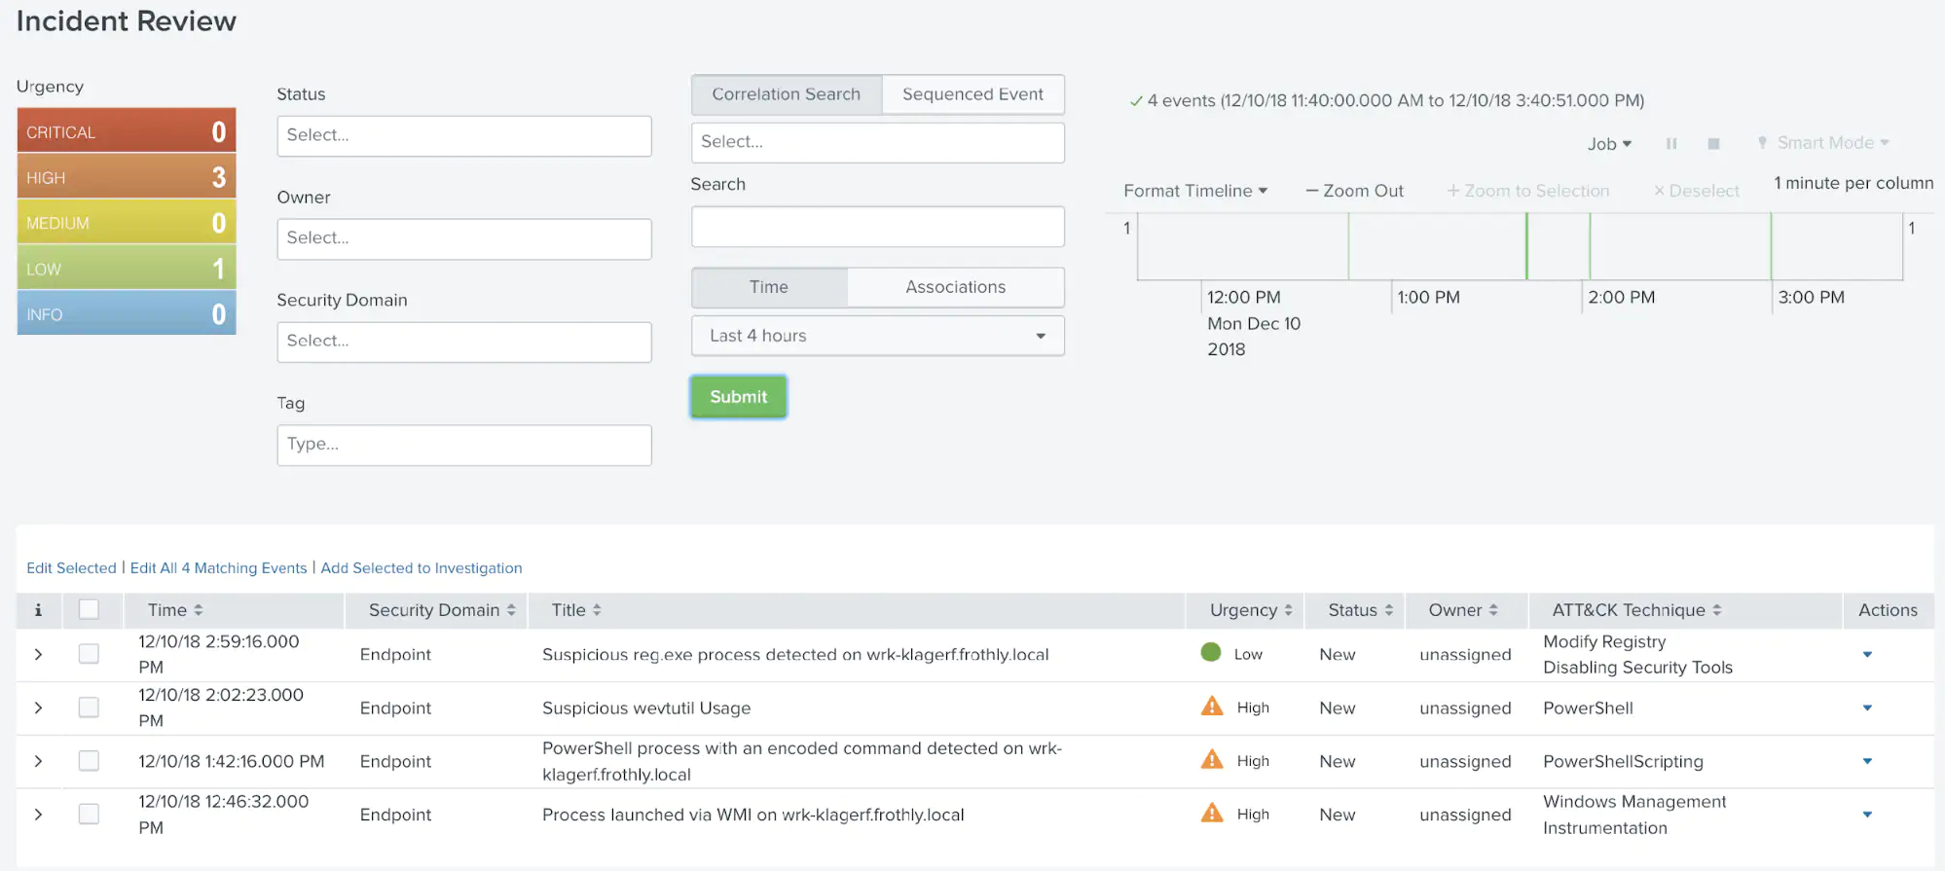
Splunk notables (Alerts) example

Slide 8
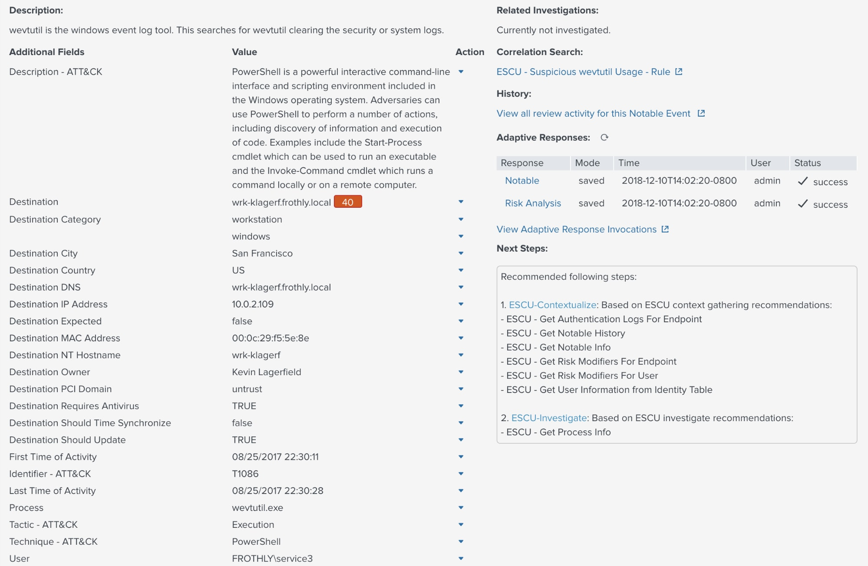
Splunk notables (Alerts) example

Slide 9
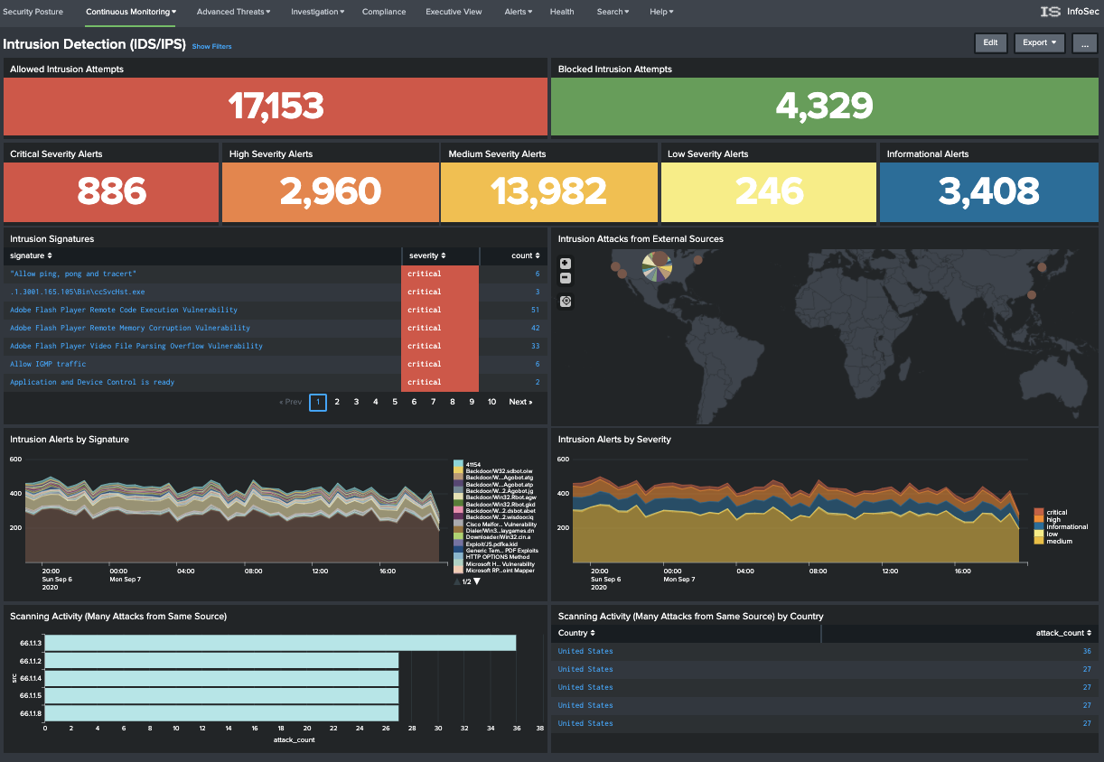
Splunk dashboard example

Slide 10
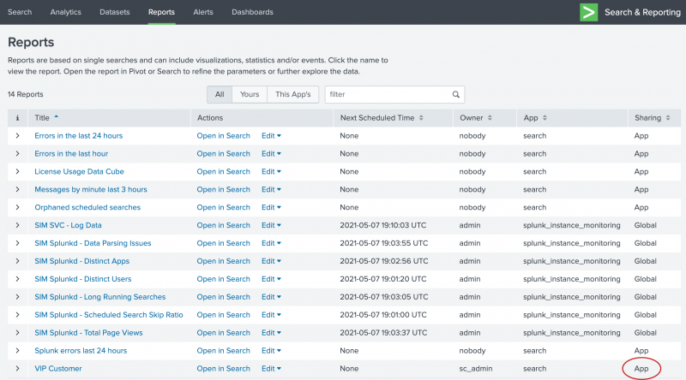
Splunk reports example

Slide 11
Triage
To triage means to assign a level of importance or urgency to incidents, which then determines the order in which they will be investigated
Done in the following way:
Review the alerts by actively investigating the trigger
Close an alert if it is qualified as false positive
Park the alert if same offense triggered multiple time to understand it is false positive or legit one
Categorize the alerts based on severity and impact

Slide 12
Basic Investigation
It is the process of investigating, analyzing and gathering relevant evidences about the security incident
Done in the following way:
Identify which Rule triggered an alert
Try to collect as much information as possible.
Identify which log sources & systems triggered the alert
Identify users or potential actors involved in the an incident
Search past alerts/incidents
Understand attack vectors
Use the available threat intelligence
Search related events, flows, vulnerabilities and active exploits

Slide 13
Deep dive investigation
Perform threat hunting based on the IOC’s and IOA’s
Identify the related activity during the given timeline
Try to correlate the actions and identify the source of infection or the root cause of the activity
Use advanced detection and remediation mechanisms like EDR

Slide 14
Remediation
Gather incident information as below and forward it to respective teams
List of affected hosts
Potentials Actors / users
attack vector information
If the incident is a false positive – create tuning request and send to SOC Admin Team

Slide 15
Thank you Have a happy weekend

